Slide 1
London Museum Development Volunteer Training Bank: Disability Awareness

Slide 2
Objectives
Have an increased understanding of the Social Model of Disability.
• Will know that there are different impairment groups
• Will know that there are 3 different types of barrier which pose problems for disabled people
• Will have discussed the barriers which might exist in their setting
• Will have discussed actions that they could take to minimise the impact of these.

Slide 3
Understanding Disability

Slide 4
How do you think about Disability?

Slide 5
Social Model

Slide 6
Social Model… in an ideal world

Slide 7
Impairment Groups
Mobility
Visual
Hearing
Mental health
Learning difficulty
Long-term health condition / hidden

Slide 8
Break

Slide 9
3 Types of Barriers
Physical
Informational / Communication
Attitudinal

Slide 10
Barriers & Impairments
People from different impairment groups experience different barriers / the same barriers differently

Slide 11
Removing Barriers Discussion

Slide 12
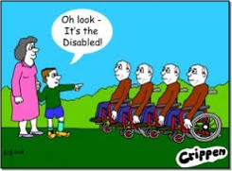
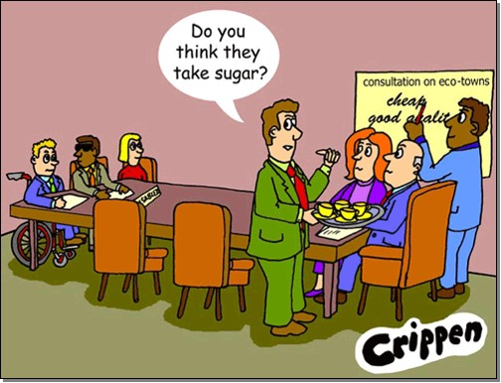
Language
Disability Etiquette:
Don’t want to offend?
Not sure what to do?
Not sure what not to do?

Slide 13
Common Etiquette Scenarios Card Game
Pass the cards out with scenarios face up
Do not turn the cards over
One-by-one read out your scenario and invite group to offer up solutions
When the correct answer is achieved your card is turned over and the next person shares their scenario

Slide 14
Any Questions?
Please remember to complete your evaluation form before you leave.
For other training sessions, please visit the Volunteer Training Bank on the London Museum Development Team’s website:
http://www.museumoflondon.org.uk/supporting-london-museums/resources/training-bank

Slide 15
This presentation and its contents, unless otherwise indicated, © Museum of London, 2015. All Rights Reserved.

